Slide 1
Vision Powered
Pick and Place Robot
Supervised by
Dr. Khalid Wassif
Implemented by
Abanob Effat 20156001
Hisham Mahfouz 20156015

Slide 2
Agenda
Project Idea
Motivation
Problem Significance
Technologies
Project Specifications
System Architecture
Techniques
Problems
Time Plan
Conclusion
Future work

Slide 3
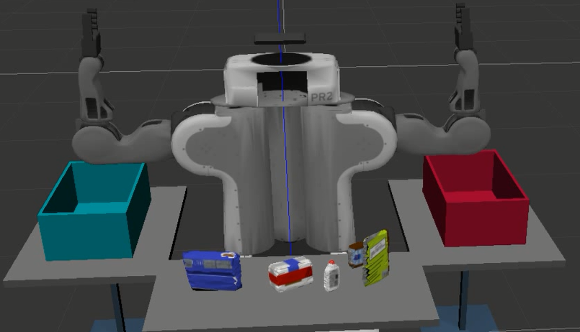
Project Idea
Create a robot that have a mind of his own to perceive the environment and decide what action to take without any human supervision
Notes:
Our Objective is to build a Pick and place robot arm to substitute human labor in an automated manner.
Many companies used robots to automate their production cycle.
The main solution was that the robot should have a mind of his own to perceive the environment and decide what to do without any kind of human supervision.

Slide 4
Motivation
Tedious and repetitive Tasks
Tasks that require a certain degree of precision.
Tasks that is dangerous.
Remote Tasks

Slide 5
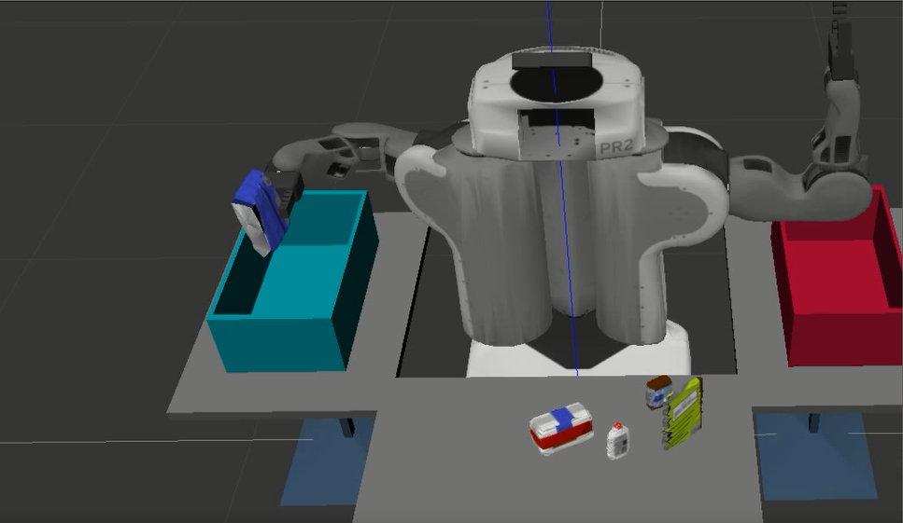
Problem Significance - What
Our problem is building a robot arm in a warehouse that place each type of item in its designated box.

Slide 6
Problem Significance – why?
Remove human labor cost.
Eliminate Human error.
Maximize efficiency.

Slide 7
Problem Significance - how?
The robot in our project have 3 main activities like most robots do.
Perceiving the environment.
Decision making.
Performing action.

Slide 8
Technologies
ROS
Gazebo
RVIZ

Slide 9
Technologies - ROS
ROS is an open-source, meta-operating system for robots.
Divides the System to Nodes and Topics
Uses Message passing to send data by publishing and subscribing to a certain Topic
Package Management
Notes:
It provides: the services you would expect from an operating system, including hardware abstraction, low-level device control, implementation of commonly-used functionality, message-passing between processes, and package management.

Slide 10
Technologies - Gazebo
Gazebo is a simulation environment that allows for testing of complex systems – robotic or otherwise.
It has many uses, including testing the dynamics of a control system before the system has been actualized.

Slide 11
Technologies - Rviz
Rviz is a 3D visualizer for displaying sensor data and state information of robot.
Used In
Controlling over robot.
Debugging robot.
Displaying robot movement and data.

Slide 12
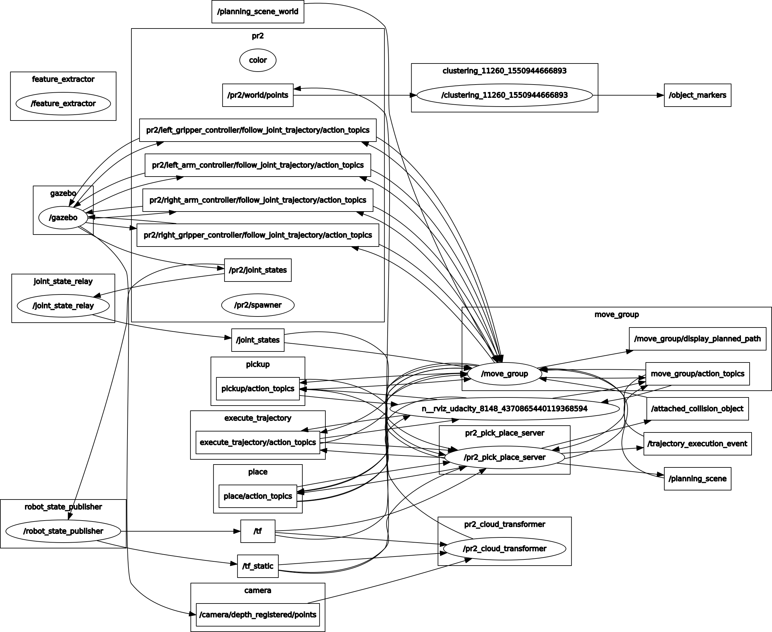
Specification - System Architecture

Slide 13
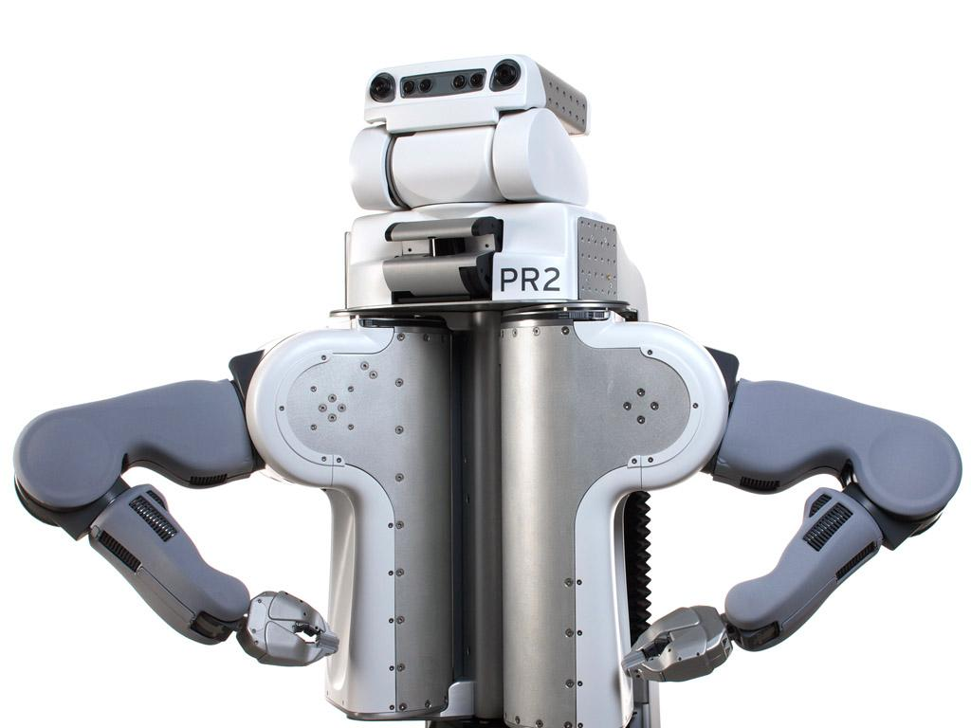
Our Robot - PR2
PR2 was made in 2010 by Willow Garage. It is equipped with two 7-degree of freedom arms. It also have an RGBD camera mounted on its head and other variety of sensors.

Slide 14
Specification - Techniques
Machine Learning
Computer Vision
Path Planning
Kinematics

Slide 15
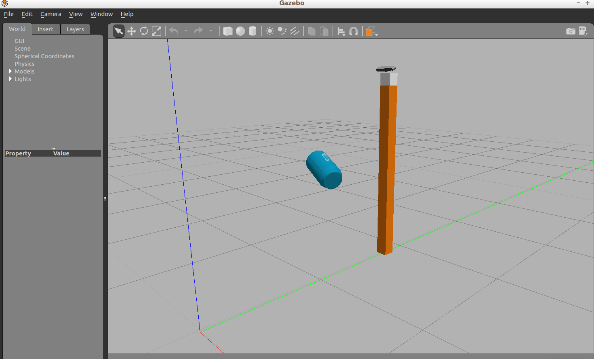
Techniques - Machine Learning
In Machine learning domain a creation of a model is done using a support vector machine (SVM) that can classify different objects.
Extraction of the dataset.
Create the model.
Notes:
Features are distribution of surface normal represented in histogram and color histogram

Slide 16
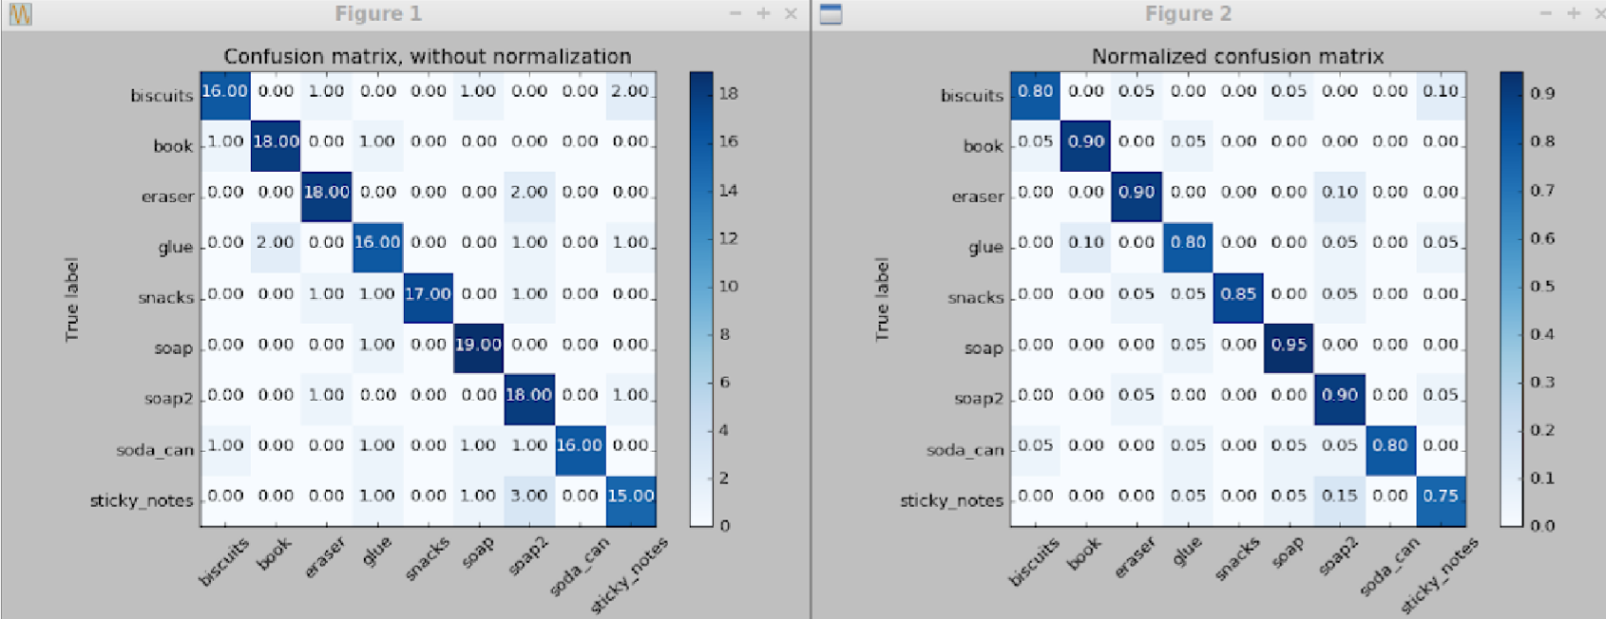
Techniques - Machine Learning

Slide 17
Techniques - Computer Vision
In Computer vision domain several filters and techniques are used in Object detection and recognition.
Statistical outlier filter
Voxel grid filter
Passthrough filter
RANSAC filter
Euclidean Clustering

Slide 18
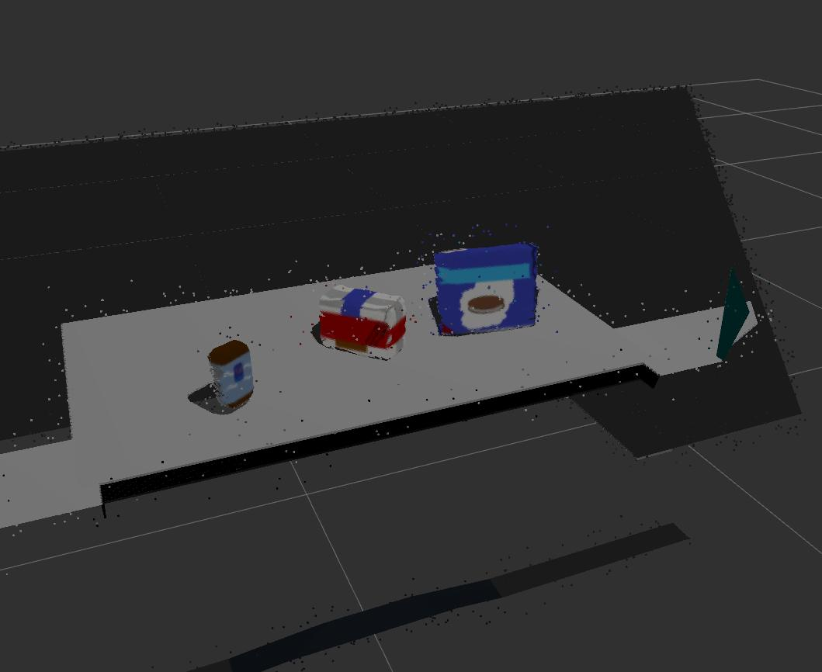
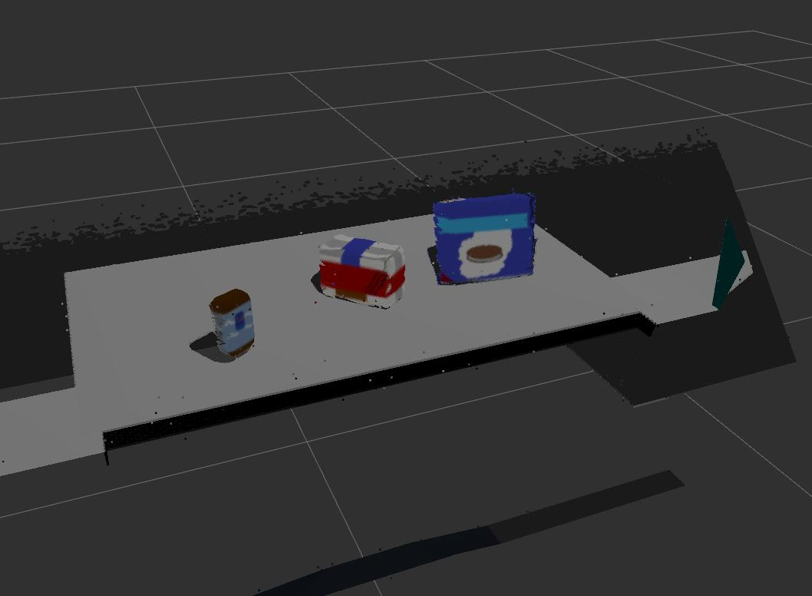
Computer Vision-Statistical outlier filter

Slide 19
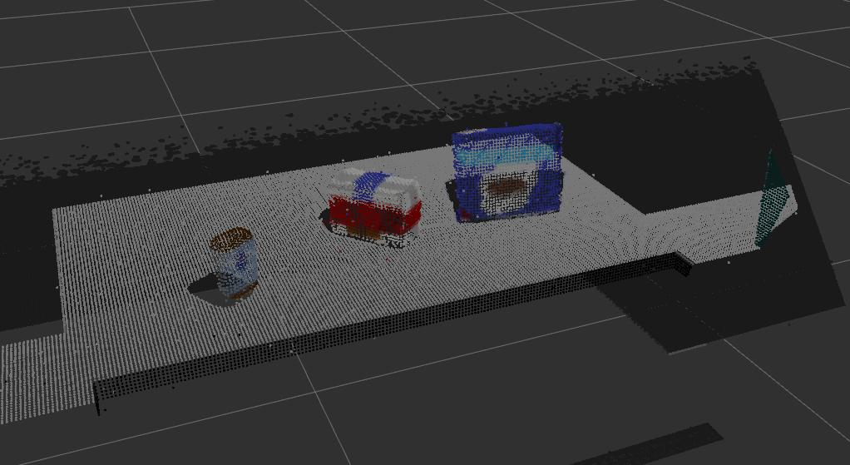
Computer Vision-Voxel grid filter

Slide 20
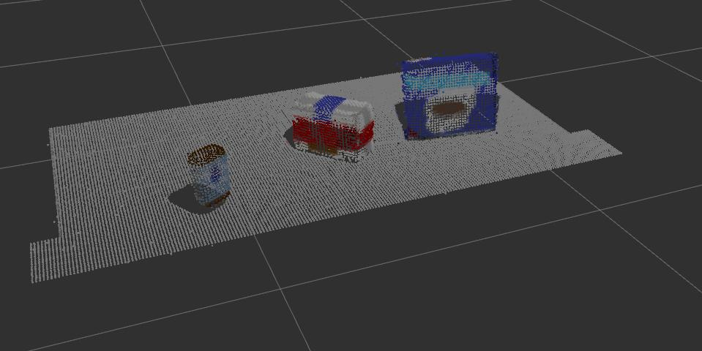
Computer Vision-PathThrough filter

Slide 21
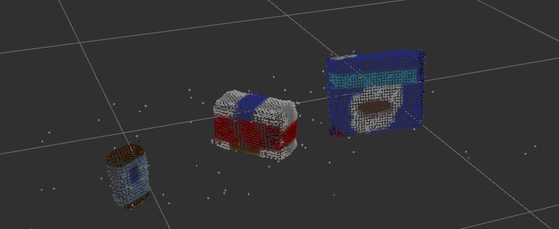
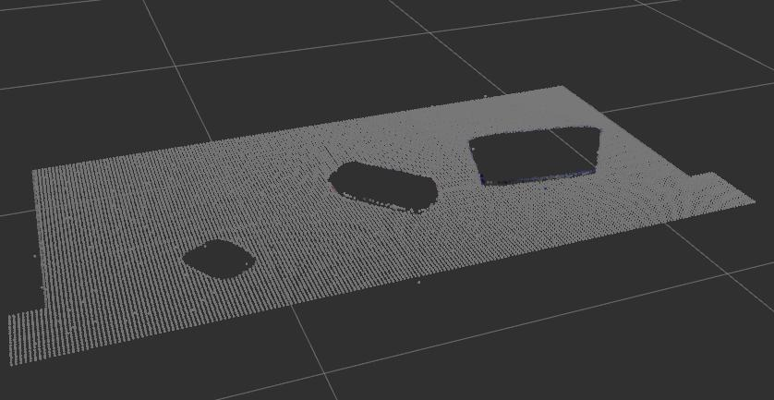
Computer Vision-RANSAC filter

Slide 22
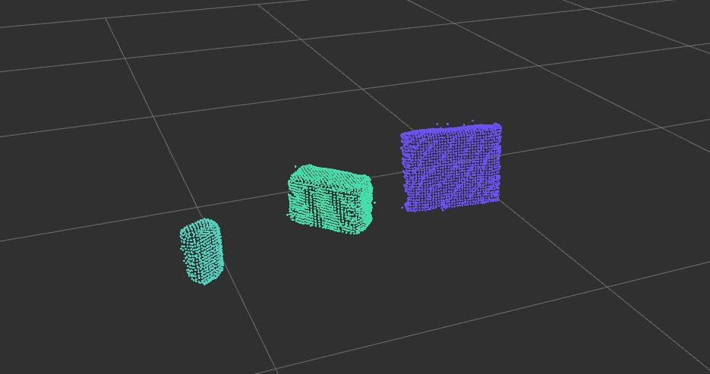
Computer Vision-Euclidean Clustering

Slide 23
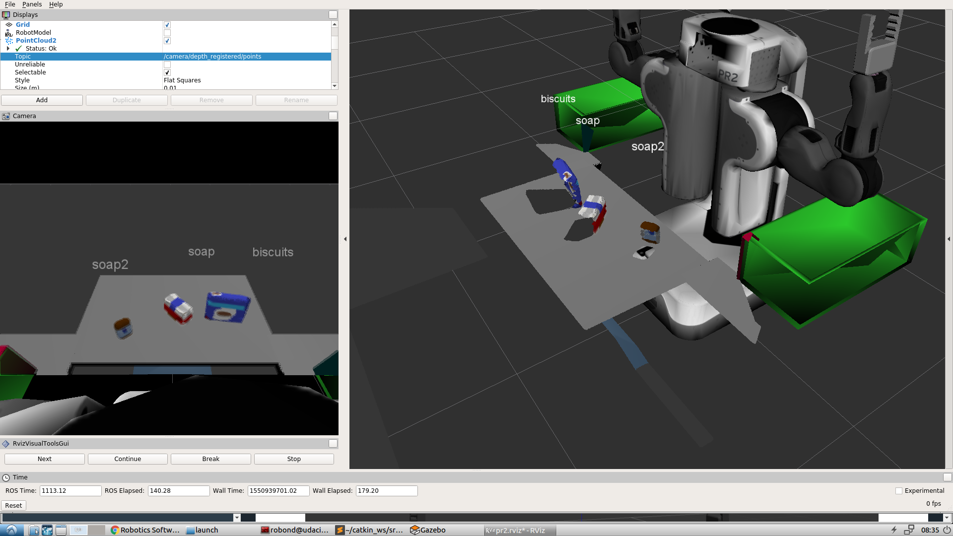
Computer Vision-Object Detection

Slide 24
Techniques - Path Planning
Moving an arm to a different location (in joint space) or the end-effector to a new pose require the arm to follow a path.
Constraints
Collisions(including self-collisions).
Position constraints
Orientation constraints
Visibility constraints
Joint constraints
User-specified constraints
Notes:
Position constraints - restrict the position of a link to lie within a region of space
Orientation constraints - restrict the orientation of a link to lie within specified roll, pitch or yaw limits
Visibility constraints - restrict a point on a link to lie within the visibility cone for a particular sensor
Joint constraints - restrict a joint to lie between two values
User-specified constraints - you can also specify your own constraints with a user-defined callback.

Slide 25
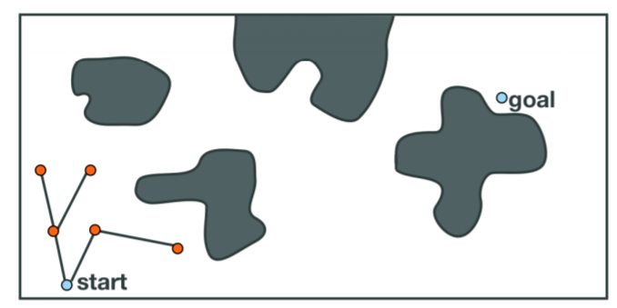
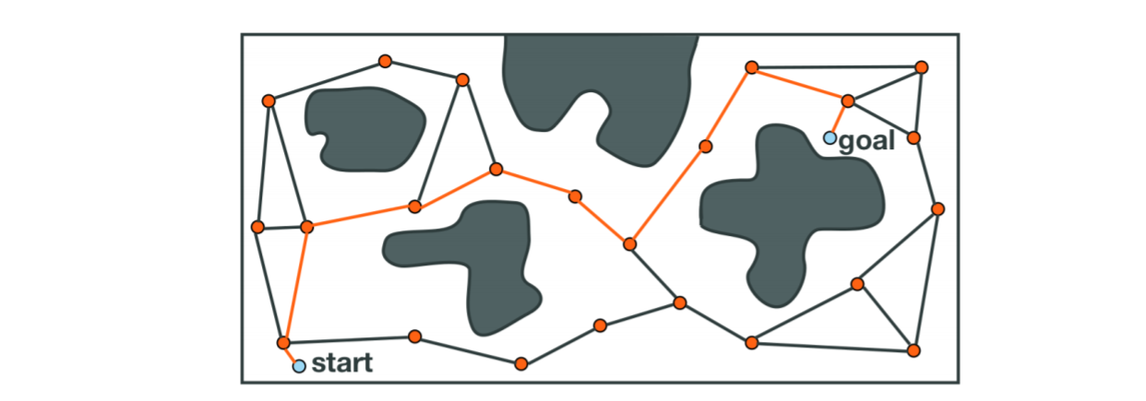
Techniques - Path Planning

Slide 26
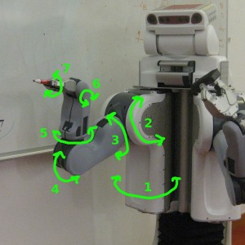
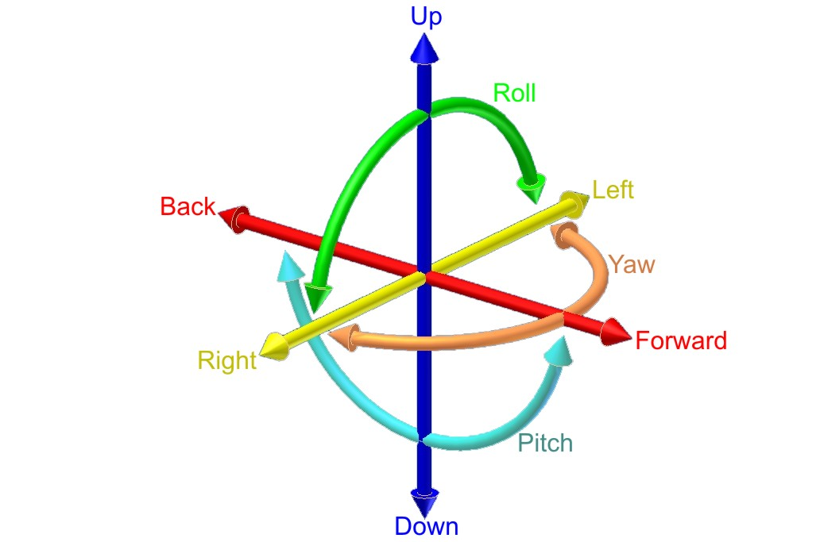
Degrees of Freedom

Slide 27
Techniques - Kinematics
Pr2 Robot has two arms in order to calculate the pose and orientation of the object to the robot arm “End-effector” and then make the arm follow a path to perform these action we need to calculate two things.
Forward Kinematics
Inverse Kinematics

Slide 28
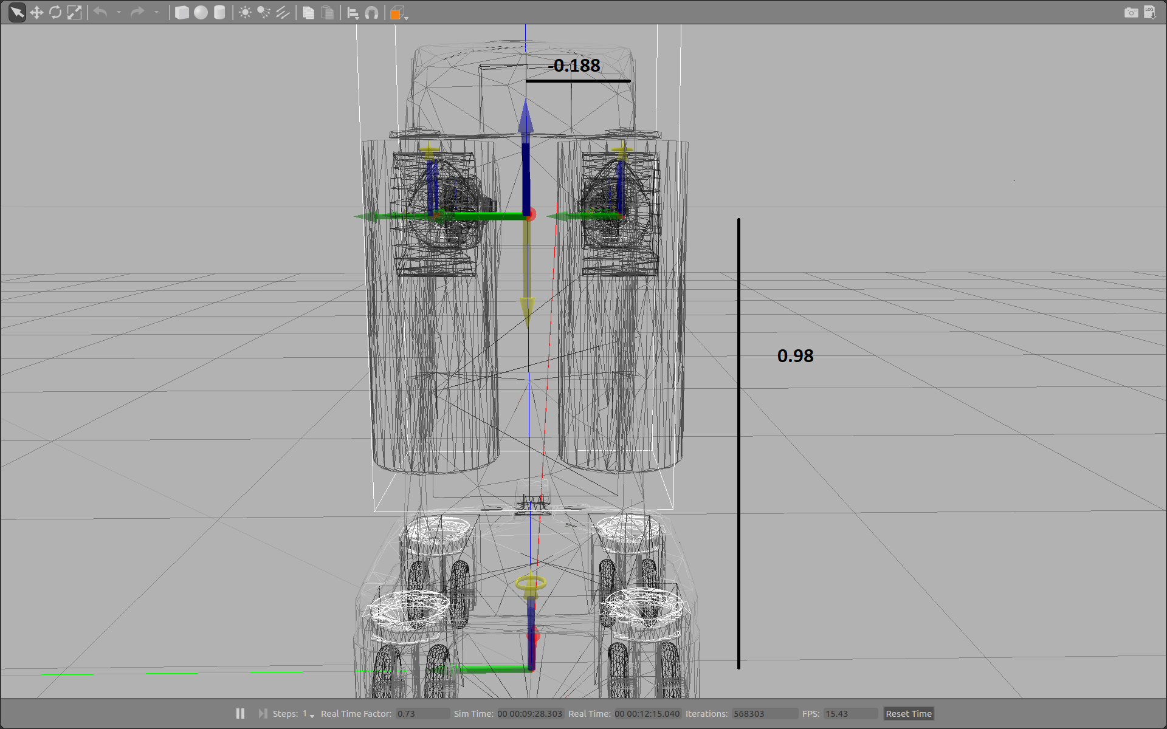
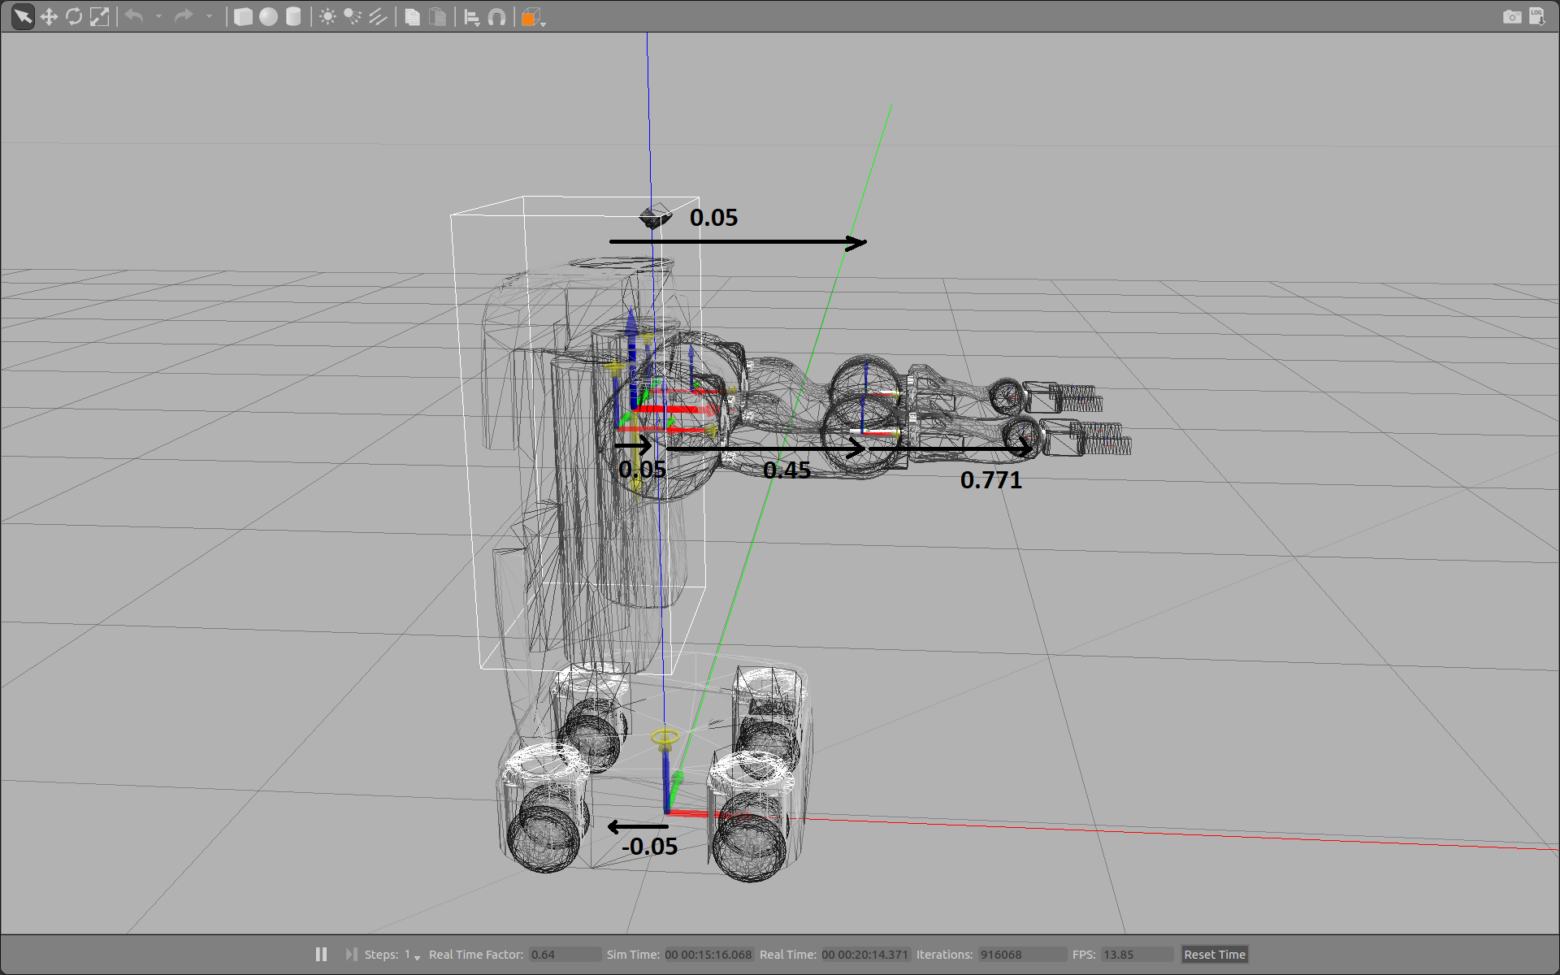
Forward Kinematics
Notes:
The Forward Kinematics function/algorithm takes a pose as the input, and calculates the position of the end effector as the output.
we know all the joint variables, that is the generalized coordinates associated with the revolute and prismatic joints, and we wish to calculate the pose of the end effector in a 3D world.
First build up DH table then do Homogeneous Transforms from the base to the end effector

Slide 29
Inverse Kinematics
In the Inverse Kinematics problem the position and orientation of the end effector is known and the objective is to solve for the joint variables.

Slide 30
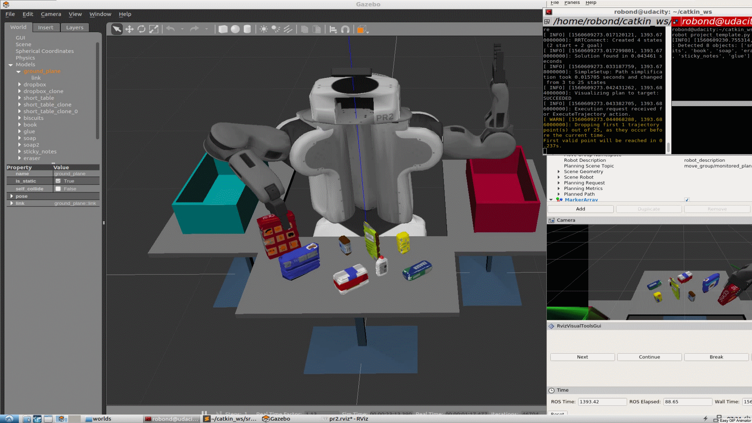
Problem-1

Slide 31
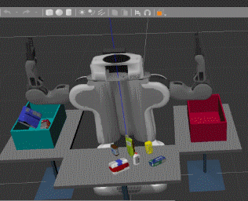
Problem-2

Slide 32
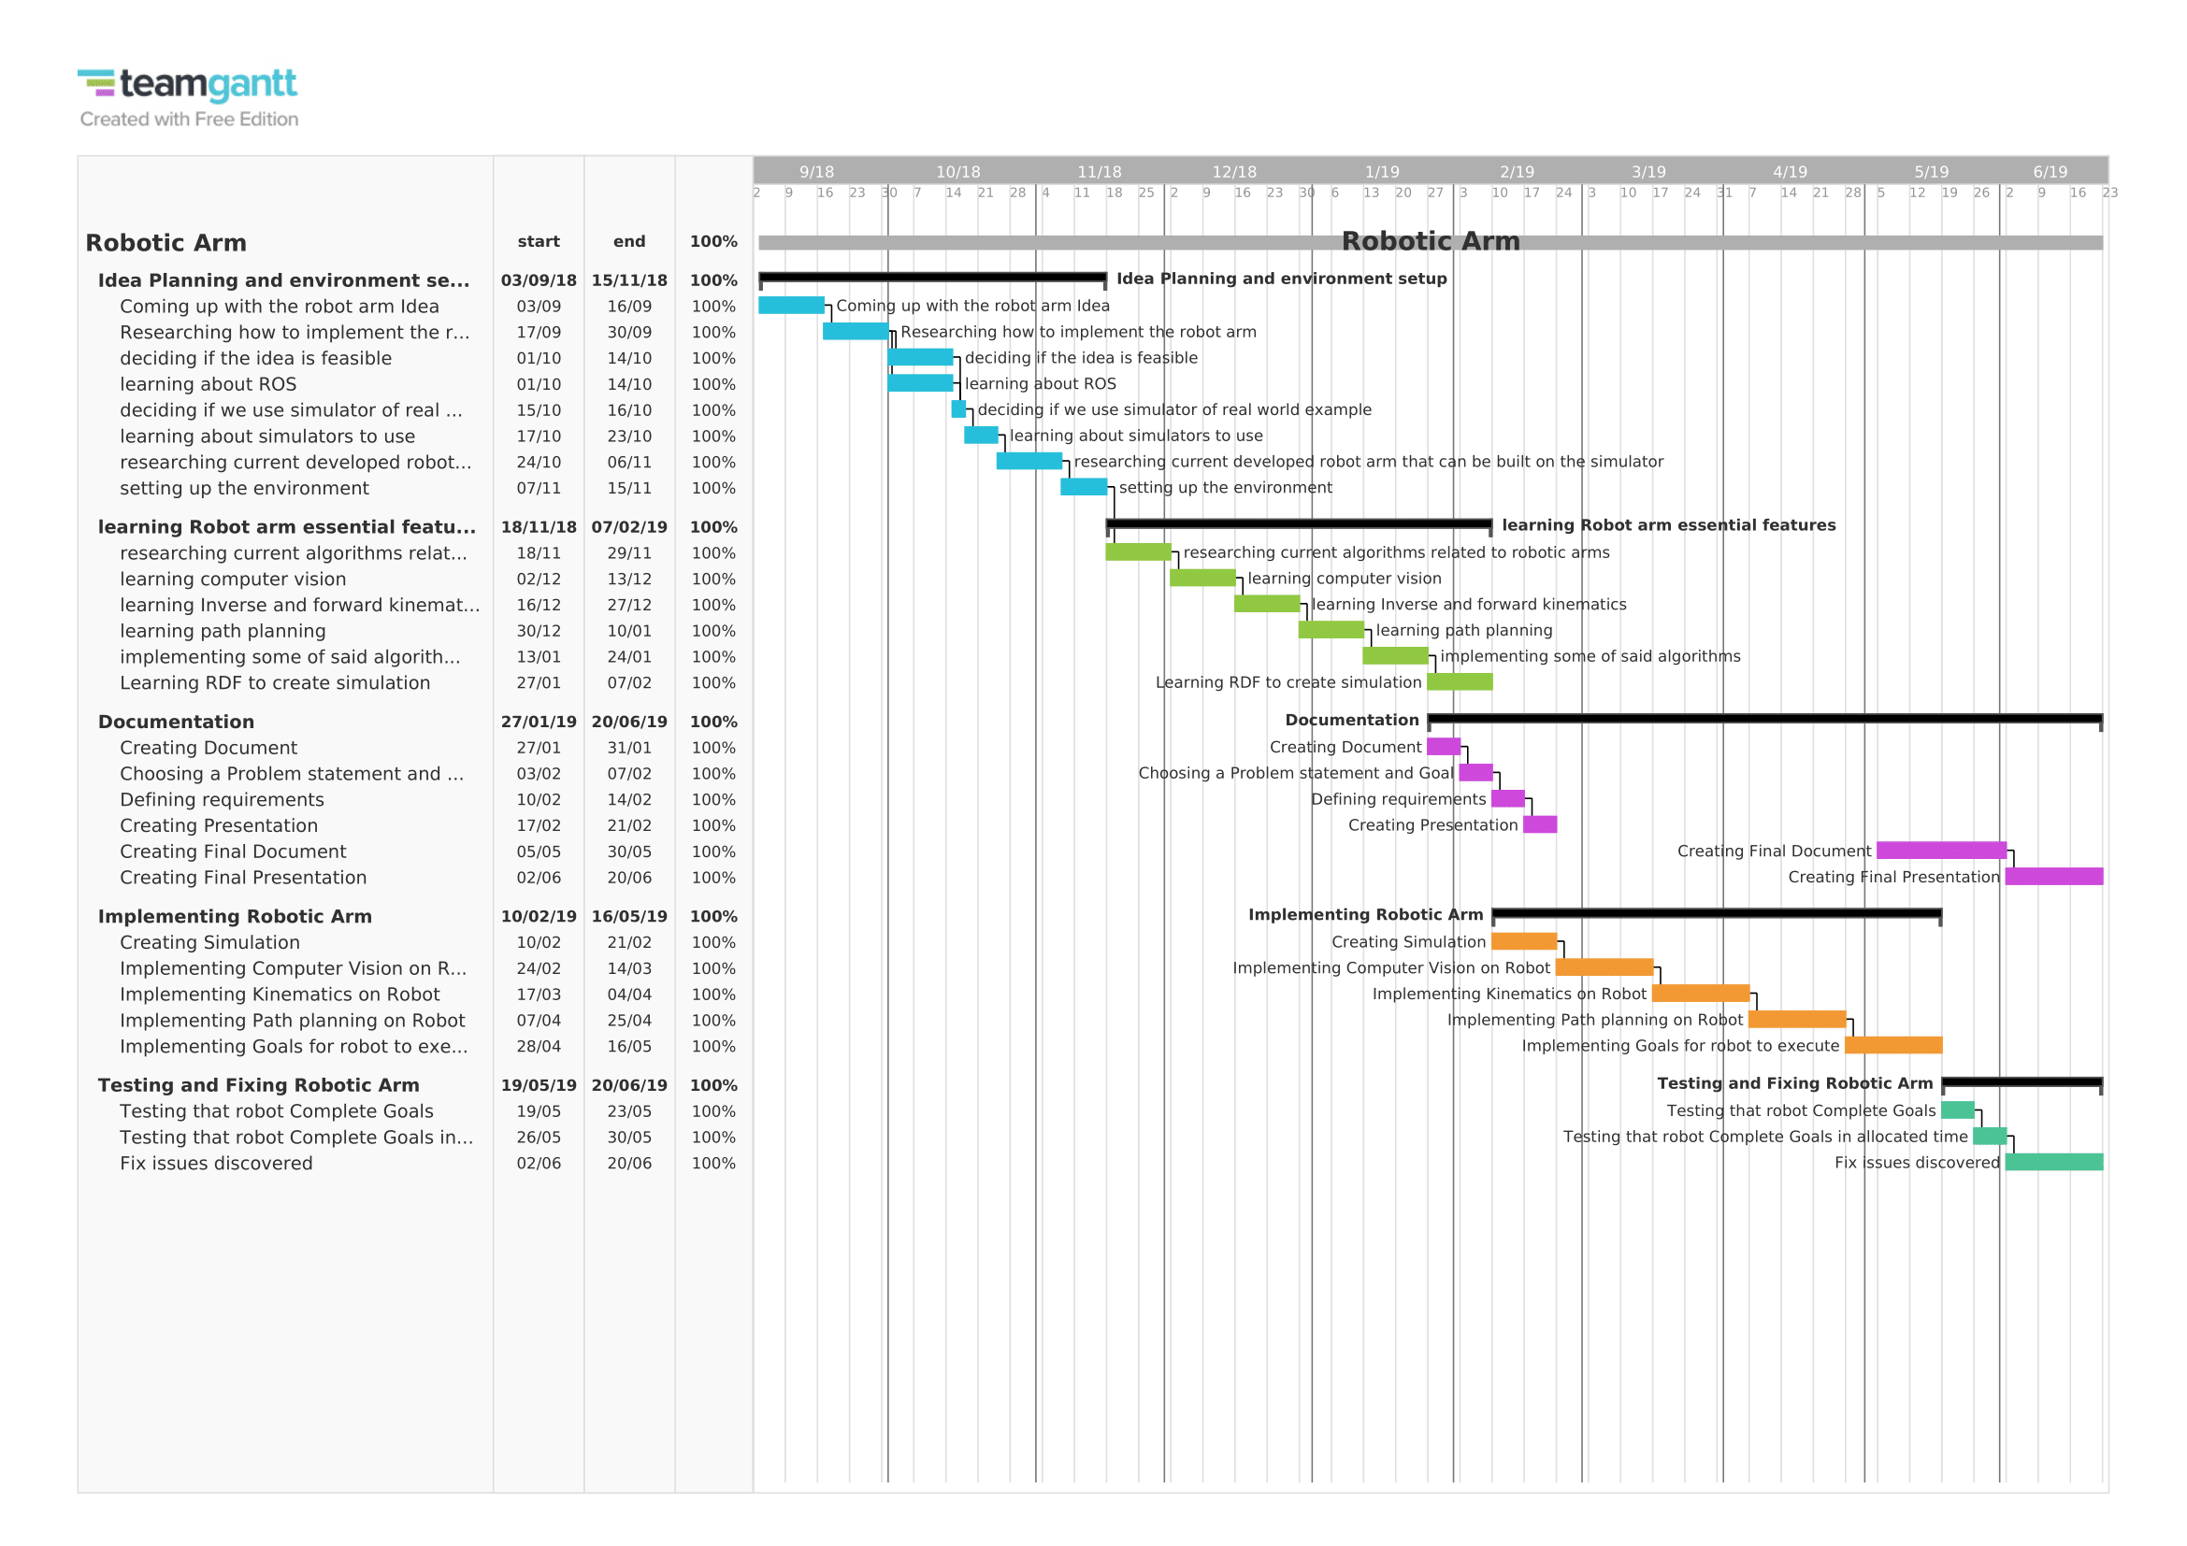
Time Plan

Slide 33
Conclusion
Robots major task are the pick and place, we used computer vision to detect items in the scene, used machine learning model to identify each item, then we performed the pick and place.
What we tried to achieve is to make the robot self-dependent and doesn't need any human supervision and that's what we achieved, of course further improvement is still needed as we lacked the computational power which affected the performance of the robot.

Slide 34
Future Work
For performance issues we needed more computational power but as it costs a lot we planned to use several laptops as nodes to help in improving the performance and it was marked as future work as we need to search for more papers that talks about this task before going for implementing this idea

Slide 35
Questions

